Slide 1
Preparation for Assessment 1

Slide 2
Overall Module Assessment
Assessment of COM410 (Programming in Practice)
100%
Assignment 1: Lab-based Assessment
40%
Part 1 – Blackboard Short Questions Quiz
40% of Ass 1
Part 2 – Individual Development Exercise
60% of Ass 1
Assignment 2: Individual Development Project
60%

Slide 3
Assignment 1 40%

Slide 4
Assessment 1
This assignment contributes 40% to the overall coursework mark for the module. It will be conducted as a lab test during the Week 6 Lab session.
The assessment will be a computer-based test administered via the Blackboard platform and consists of two parts:
Part 1: A 30-minute Blackboard Short Questions Quiz worth 40%.
Part 2: A 60-minute Individual Development Exercise requiring the creation of a small Java application, worth 60%.
Students must complete the assessment within their scheduled lab session.

Slide 5
Rules
This is an OPEN BOOK Assignment. All online and offline resources may be consulted during the assessment.
The assessment is time-limited and must be tackled within a single session of at most 90 minutes.
Part 1 is conducted and submitted directly in the Blackboard.
Part 2 is conducted the computer, and the submission will consist of screenshots of the output of your application, plus copies of the Java code files then submitted on the Blackboard link.

Slide 6
Topics Covered
The questions will relate to the work covered in the first 5 weeks of the module:
A1. Object Oriented Concepts
A2. Java Basics
A3. Abstract Data Types
A4. Linked Structures
A5. Stacks and Queues

Slide 7
Part 1 - Short Questions Quiz (40 marks)

Slide 8
1- Question 1 – A (3 marks)
An array of integers called myArray has been defined as follows:
int[] myArray = { 45, 13, 47, 28, 33 };
Provide fragments of Java code for the following two tasks:
Write Java code to add 10 to each element of the array.
for (int i = 0; i < myArray.length; i++) {
myArray[i] += 10;
}
Explanation
A traditional for loop is used to iterate through each index of the array.
myArray[i] += 10; adds 10 to the current element at index i.
This approach is straightforward and modifies the array in place.

Slide 9
2- Question 1 – B (3 marks)
An array of integers called myArray has been defined as follows:
int[] myArray = { 45, 13, 47, 28, 33 };
Provide fragments of Java code for the following two tasks:
(b) Write Java code to find and print the biggest value in the array.
int biggest = myArray[0];
for (int i = 1; i < myArray.length; i++) {
if (myArray[i] > biggest)
biggest = myArray[i];
}
System.out.println(“Biggest is “ + biggest);
Explanation
The first element of the array (myArray[0]) is assumed to be the largest initially.
The for loop starts from the second element (i = 1) and iterates through the array.
If a larger element is found, max is updated.
After the loop completes, max contains the largest value, which is then printed.

Slide 10
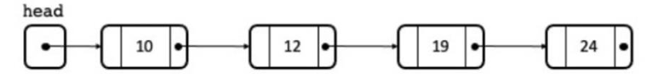
3- Question 2 – A (4 marks)
A linked chain of integer objects is used to maintain a collection of values in ascending order as shown below. Each node can reference the next node in the chain and the first node is indicated by the node pointer head.
Describe the steps involved in returning the value of the last node in the chain. The node should not be removed from the chain.
N.B. You are not required to write any Java code.

Slide 11
Explanation for the chain
A singly linked list consists of a sequence of nodes, where each node contains:
A value (data).
A pointer that references the next node in the sequence.
The Head has no value but has a pointer to the 1st node.
The last node has a value but has a pointer = null.
If the list is empty, then the head = null.
Traversing the List - to access any element in the list, start at the head and follow the next pointers until the desired node is reached.
Insertion of new node – new node is created with initial pointer = null + the pointer updated to the pointer of the head + the head updated to pointer the new node.

Slide 12
If head is null, return null
Else
Set a pointer to head
While the next field of the node indicated by the pointer is not null
Set the pointer to the next field of the node currently pointed at
End While
Return the value of the node indicated by the pointer
End If
Explanation:
If there are no nodes in the linked list (head is null), there is no last node, so we return null immediately.
Start from the first node in the linked list.
Continue moving through the list until a node with next = null is found, meaning it is the last node.
Move step-by-step from one node to the next by assigning the pointer to the next field of the current node.
When the loop exits, the pointer is at the last node, so we return its value.

Slide 13
4- Question 2 – B (4 marks)
(b) Describe the steps necessary to add a new element to the chain, maintaining the sorted order. Assume that the new element will be the smallest value in the list.
N.B. You are not required to write any Java code.
If the head is null,
Set the head to point to the new element and return
Else
Set the next field of the new element to head
Set head to point to the new element
End If
If there are no nodes in the list, the new element becomes the first node + The head pointer is updated to reference this new node + Since there are no other nodes, return immediately.
The new element needs to be inserted at the beginning because it is the smallest value + The next field of the new node is set to point to the current head, ensuring the existing list is preserved.
The head is updated to point to the new node, making it the first node in the list.

Slide 14
Question 3
Suppose there exist 3 empty stacks (a, b, c) that permit integer values to be stored.
Stacks should be described from left to right, where the rightmost item is that at the top of the stack, hence if 10 and 20 are pushed onto an empty stack in turn, the stack would be described as: Stack: 10, 20.
Show the contents of stacks a, b and c after each of the following groups of statements is executed. The effect should be cumulative – hence the operations in the second group should reflect that those in the first group have been completed.

Slide 15
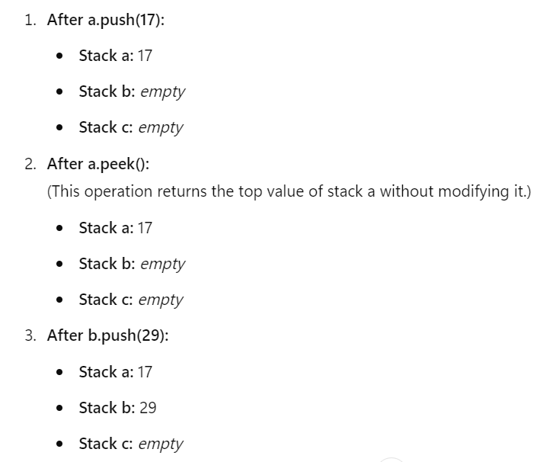
5- Question 3 – A (3 marks)
a.push(17)
a.peek()
b.push(29)
Answer:
Stack a: 17
Stack b: 29
Stack c:

Slide 16
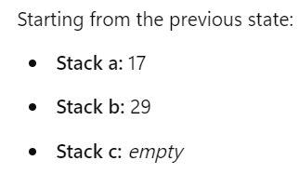
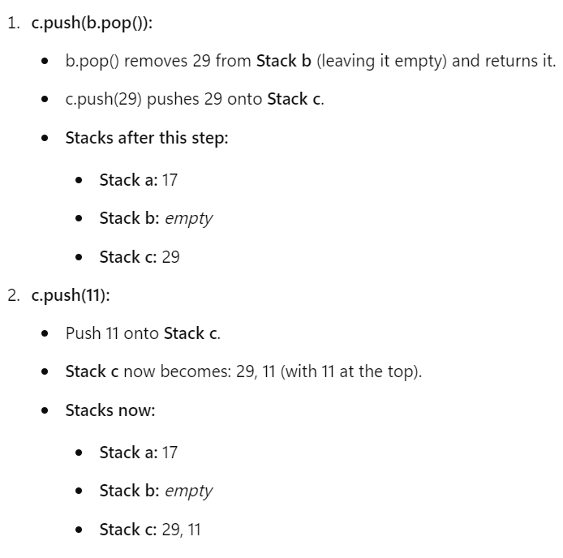
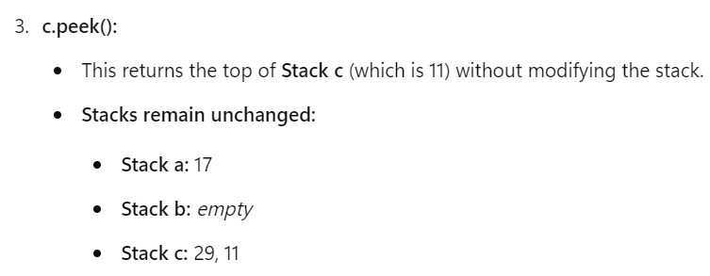
6- Question 3 – B (3 marks)
c.push(b.pop())
c.push(11)
c.peek()
Answer:
Stack a: 17
Stack b:
Stack c: 29, 11

Slide 17
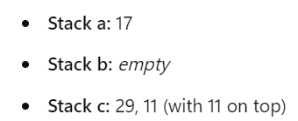
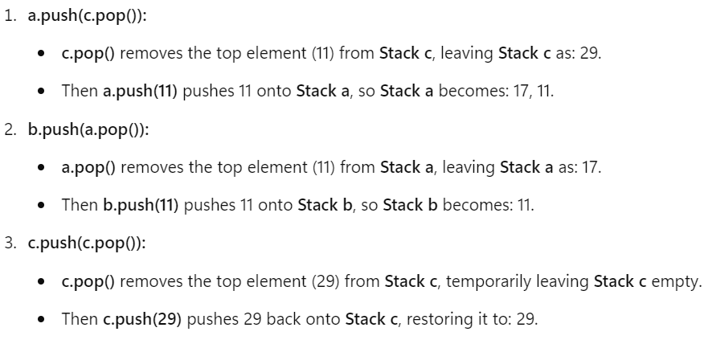
7- Question 3 – C (3 marks)
a.push(c.pop())
b.push(a.pop())
c.push(c.pop())
Answer:
Stack a: 17
Stack b: 11
Stack c: 29

Slide 18
Extra Questions of the Queue
Suppose there exist 3 empty queues (a, b, c) that permit integer values to be stored. Queues should be described from left to right, where the leftmost item is the front and the rightmost item is the rear. Hence, if 10 and 20 are enqueued onto an empty queue in turn, the queue would be described as: Queue: 10, 20
Show the contents of queues a, b, and c after each of the following groups of statements is executed. The effect should be cumulative – hence the operations in the second group should reflect that those in the first group have been completed.

Slide 19
Part A
a.enqueue(17)
a.peek()
b.enqueue(29)
Answer
Queue a: 17
Queue b: 29
Queue c: empty

Slide 20
Part B
c.enqueue(b.dequeue())
c.enqueue(11)
c.peek()
Queue a: 17
Queue b: empty
Queue c: 29, 11 (Note: c.peek() returns 29)

Slide 21
Part C
a.enqueue(c.dequeue())
b.enqueue(a.dequeue())
c.enqueue(c.dequeue())
Queue a: 29
Queue b: 17
Queue c: 11

Slide 22
7- Question 4 (all 6 marks)
Provide the following Git commands
To create a new branch called my_branch
To move to the master branch
To delete the branch my_branch
Explanation
Git is a distributed version control system (VCS) used for tracking changes in source code during software development. It allows multiple developers to collaborate efficiently while keeping a history of all changes.
git <command> [options] [arguments]

Slide 23
Action | Command | Criteria
Create a new branch | git branch <new_branch> | Creates a branch but does not switch to it.
Create and switch to a new branch | git switch -c <new_branch> or git checkout -b <new_branch> | Creates and immediately switches to the new branch.
Switch to an existing branch | git switch <branch> or git checkout <branch> | Moves to the specified branch.
List all local branches | git branch | Displays all local branches, marking the current branch with *.
List all local and remote branches | git branch -a | Shows both local and remote branches.
Rename a branch (current branch) | git branch -m <new_name> | Renames the current branch.
Rename a branch (from another name) | git branch -m <old_name> <new_name> | Renames a specified branch.
Delete a local branch | git branch -d <branch> | Deletes a branch only if merged.
Force delete a local branch | git branch -D <branch> | Deletes a branch even if not merged.
Delete a remote branch | git push origin --delete <branch> | Removes the branch from the remote repository.
Push a new branch to remote | git push origin <branch> | Uploads a local branch to the remote repository.
Set upstream tracking for a branch | git push -u origin <branch> | Pushes the branch and sets remote tracking for future sync.
Merge a branch into the current branch | git merge <branch> | Combines the specified branch into the current branch.
Abort a merge | git merge --abort | Cancels a merge operation.
Check the branch you are on | git branch --show-current | Displays the name of the currently checked-out branch.

Slide 24
7- Question 4 – A (2 marks)
Provide the following Git commands
(a) To create a new branch called my_branch
git switch -c my_branch

Slide 25
8- Question 4 – B (2 marks)
Provide the following Git commands
(b) To move to the master branch
git switch master

Slide 26
9- Question 4 – C (2 marks)
Provide the following Git commands
(c) To delete the branch my_branch
git branch -d my_branch

Slide 27
10- Question 5 (3 marks)
Explain the meaning of T in the method header
public static void myMethod(T aValue)
T is the Generic Type which allows a method that could potentially operate on various types to be specified once only. The type to be used is specified as the method is called.

Slide 28
11- Question 6 (3 marks)
Assuming you have a method
public boolean checkForValidInput(int value)
that accepts an integer parameter as input and returns true or false depending on some condition, provide the Junit statement that checks that the value false is returned when the parameter value 100 is provided.
assertFalse( checkForValidInput(100) );
Statement | Explanation
assertFalse(expression) | Asserts that the given expression evaluates to false.
checkForValidInput(100) | Calls the method with 100 as the input parameter.
Test Passes If: | The method returns false when 100 is provided.

Slide 29
Command | Description | Example
assertEquals(expected, actual) | Checks if the actual value matches the expected value. | assertEquals(10, myMethod());
assertNotEquals(expected, actual) | Ensures the values are not the same. | assertNotEquals(5, myMethod());
assertTrue(condition) | Asserts that a condition is true. | assertTrue(isValid(15));
assertFalse(condition) | Asserts that a condition is false. | assertFalse(checkForValidInput(100));
assertNull(object) | Checks if an object is null. | assertNull(myObject.getValue());
assertNotNull(object) | Ensures the object is not null. | assertNotNull(myObject.getData());
assertThrows(Exception.class, () -> {...}) | Asserts that a method throws an exception. | assertThrows(IllegalArgumentException.class, () -> myMethod(null));
assertArrayEquals(expectedArray, actualArray) | Checks if two arrays are equal. | assertArrayEquals(new int[]{1,2,3}, myArrayMethod());

Slide 30
12- Question 7 - A (2 marks)
In Test Driven Development…
Why do we initially write tests that fail before attempting to make them pass?
Before adding a new test, the application should be in a “passing” state – i.e. all existing tests pass. By adding a new test that fails, we can be sure that the failure is due to our new test.

Slide 31
Explanation
Test-Driven Development (TDD) is a software development approach where tests are written before the actual implementation. It follows the Red-Green-Refactor cycle:
Red (Fail) – Write a test that fails (because the feature is not yet implemented).
Green (Pass) – Write the minimum code to make the test pass.
Refactor – Optimize the code while ensuring all tests still pass.
TDD is useful when:
Building new features (ensures correctness from the start).
Fixing bugs (write a test to reproduce the bug before fixing it).
Refactoring legacy code (ensures existing functionality is not broken).
Writing maintainable, scalable software (easier debugging and updates).

Slide 32
13- Question 7 - B (2 marks)
(b) What is the meaning of “refactor” in the TTD cycle Fail/Pass/Refactor?
Refactoring is the process of restructuring code without changing its functionality. Once a test passes, we can alter the code to improve performance/security/maintainability/etc using the same test as a benchmark to ensure that bugs have not been introduced.

Slide 33
Part 2 - Indicative Problem (60 marks)

Slide 34
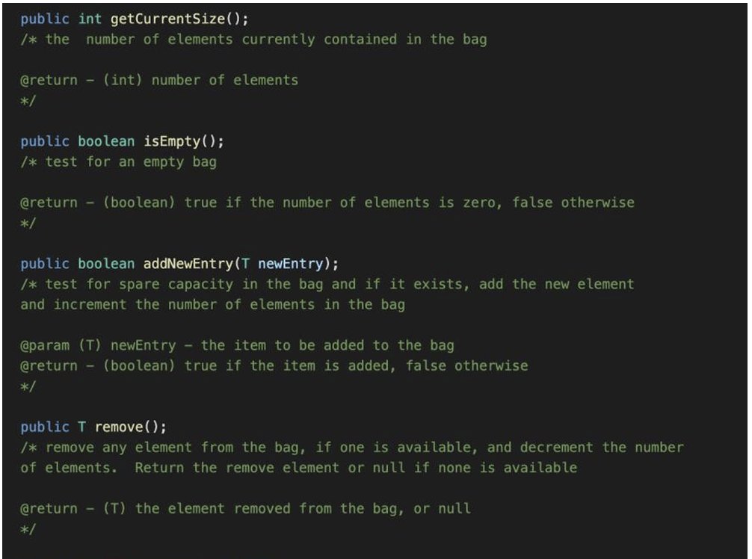
You have been provided with the file Bag.java, which defines a Bag data type as an un-ordered collection of generic elements stored in an array. The following methods on Bag objects have been implemented.

Slide 35
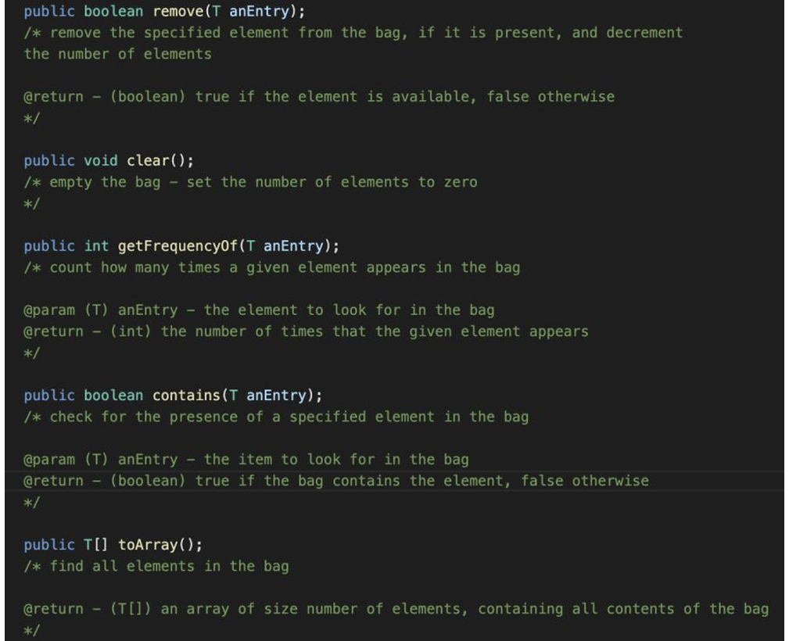

Slide 36
You have been asked to produce the new object definition BagSet, which is a variation of Bag in which any object can only appear at most once, as well as a collection of methods to apply to BagSet objects.
Tasks
Create a new Java Project in IntelliJ called Assignment1 and copy the files Bag.java, BagSet.java and BagSetTest.java into its src folder.
Modify the definition of the new class BagSet so that it is defined as a sub-class of Bag.
Write a new addNewEntry() method for BagSet that overrides the inherited behaviour and prevents any value being added to the BagSet more than once.
Provide the code for the following new methods for BagSet (the skeletons of each of these methods have been provided for you, and you should discard any code currently in the method body). Note that these methods should be non-destructive – the state of any BagSet object is unaffected by the method.

Slide 37
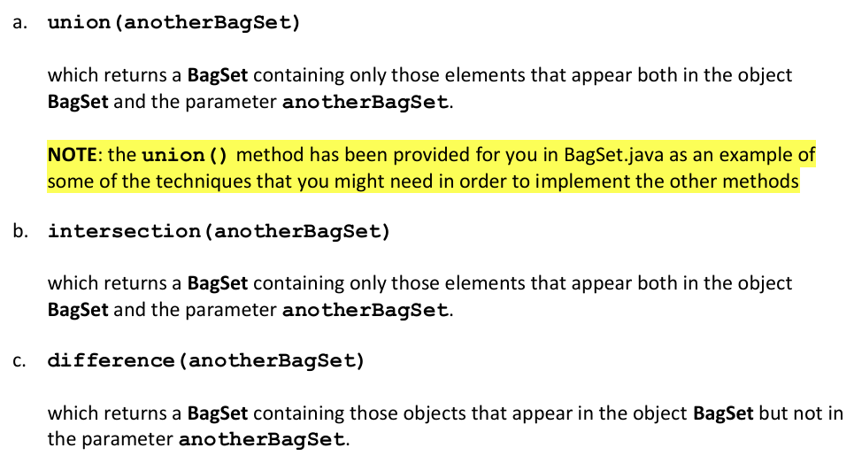

Slide 38
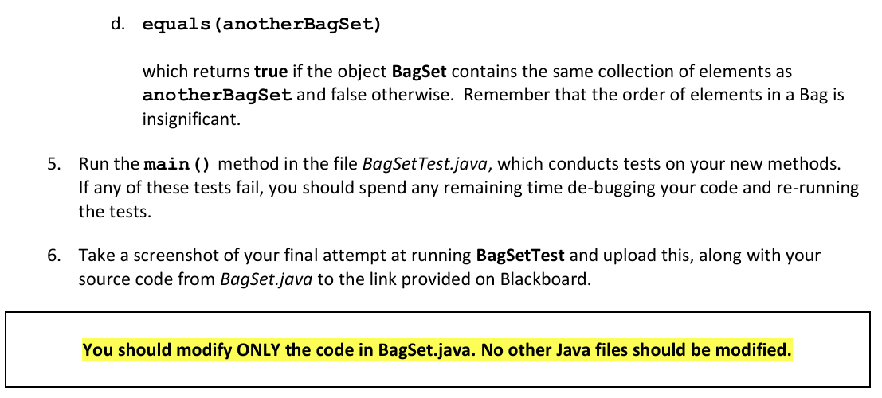

Slide 39
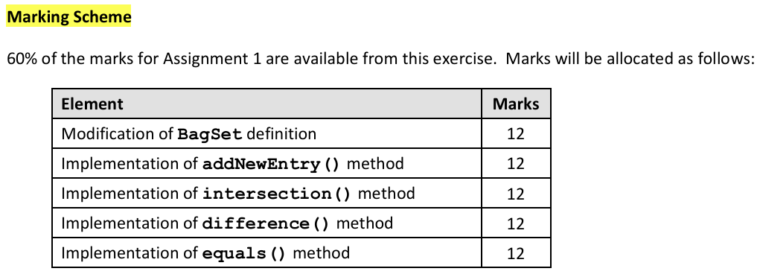

Slide 40
